Slide 1

HAPPE
By prosper jibunor
1

Slide 2
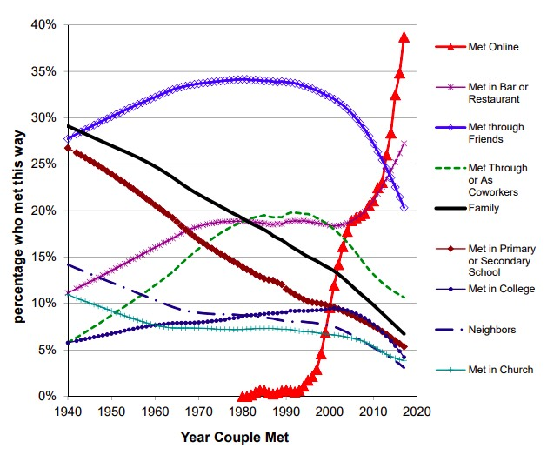
Statistics
2019 Findings from Stanford University
2

Slide 3
The Problem
Current Market
World Trends
White Space
3

Slide 4
Background & Refresher
Dating Application Created to help users find husbands & wives, NOT boyfriends and girlfriend
Emphasized on the importance of personality over looks
Kept costs low while keeping efficiency high
4

Slide 5
Numbers
Requirements: 7 of 7
TLoC Nearing 1000
Tests: 3 of 3
5

Slide 6
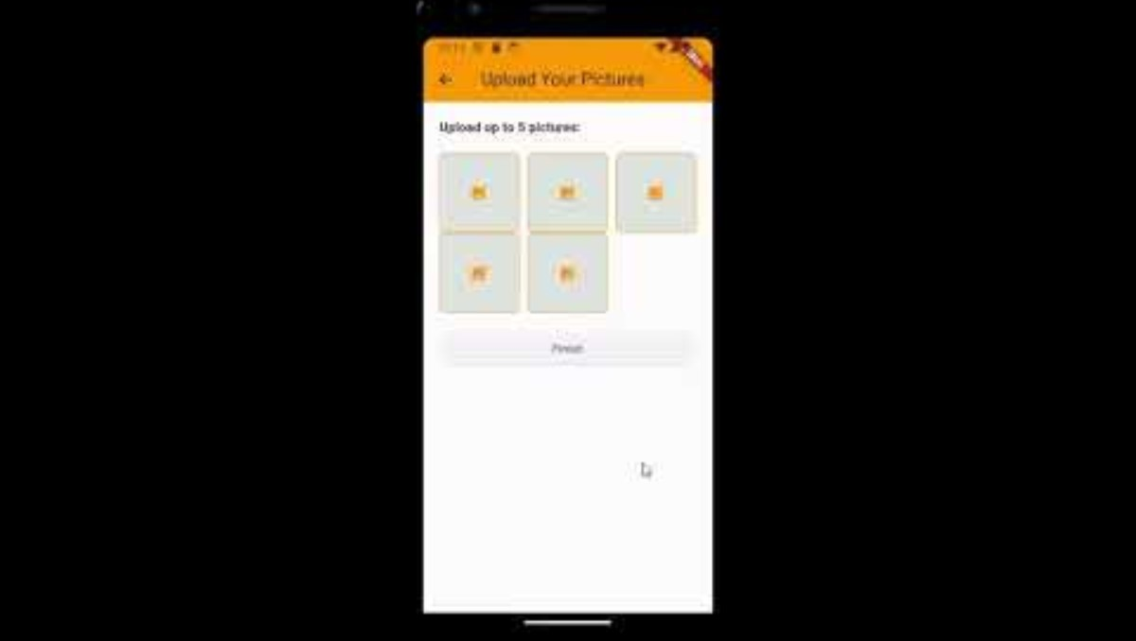
Demo
6

Slide 7
What I've Learned & What I wish I Knew
Always remember to store your progress
Have a backup plan
Keep calm, do not show emotion
Start Early, Finish Early
7

Slide 8
Future Plans
Beautify the application
Make more accessible
Add niche features like explore page
8

